Slide 1
Viral Disease in Ruminant
(BVD & FMD)
By
Assistant Professor
Dr. Jihad A. Ahmed
BVMS; MSc; PhD Animal Pathology

Slide 2
Bovine viral diarrhea virus (BVDV)
BVD was first recognised in Canada and the United States in the 1940's.
In 1987, outbreaks of BVD occurred affecting veal calves and older cattle in New York and Pennsylvania.
Beginning in 1992, an outbreak of BVD affected veal calves and dairy herds in Quebec.
Today BVDV infections are seen in all ages of cattle throughout the world and has significant economic
impact due to productive and reproductive losses.

Slide 3
Etiology
RNA virus
  Family Flaviviridae
    Pestivirus
2 biotypes: cytopathogenic (cp) or noncytopathogenic (ncp)
Both biotypes of BVDV infect cattle and cause disease, but only ncp BVDV causes persistent infections.

Slide 4
Effect of BVDV infection on cattle
Reproductive failure: Embryonic death, Mummification, Abortions, Stillbirths
Repeated breeding syndrome
Immunosuppression
Congenital defects: Cerebellar hypoplasia, Cataract
Persistent infections: Carrier animals
Acute BVD
Bovine respiratory tract disease
Mucosal disease

Slide 5
Transmission
Persistent infected animals
Acute infected cattle
Semen
Embryo transfer
Rectal sleeves
Contaminated water
Biting insect (experimentally)

Slide 6
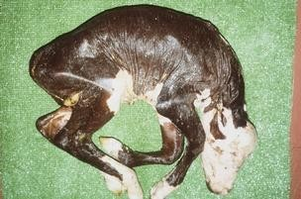

Slide 7
Critical concerns
Prenatally infected cattle and that are persistently viremic after birth
Postnatally infected cattle that are transiently viremic for about 2 to 10 days or possibly longer
Both groups of animal are considered as source of infection in herd.

Slide 8
Interspecies transfer
Sheep
Wild ruminants
  Natural infections (caribou: 40-100%)
  Transfer (llamas: dead end)

Slide 9
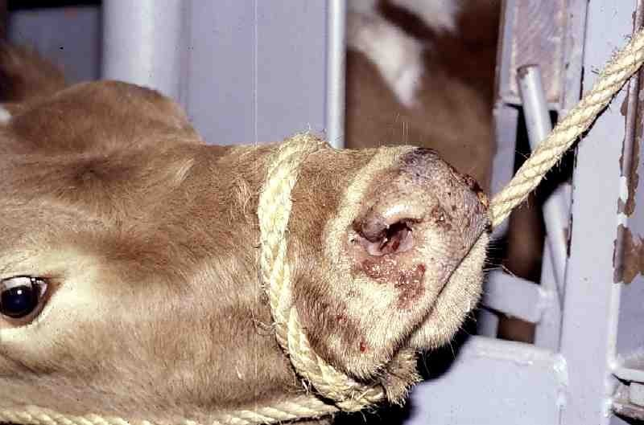
Lesion on Nose

Slide 10
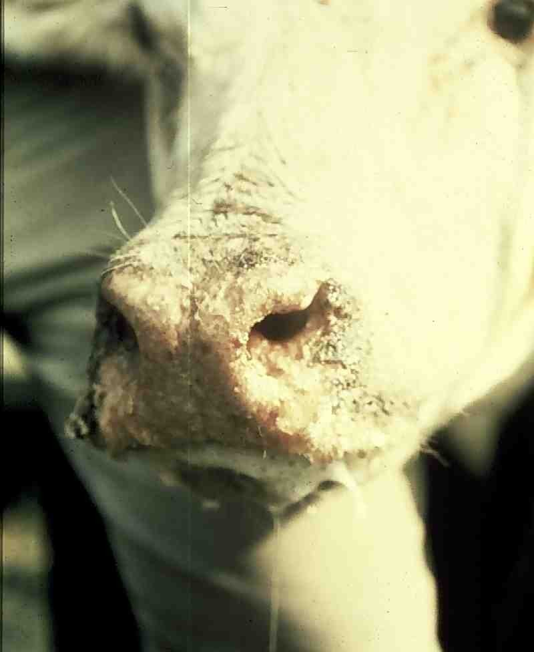
Lesion on nose, foamy saliva

Slide 11
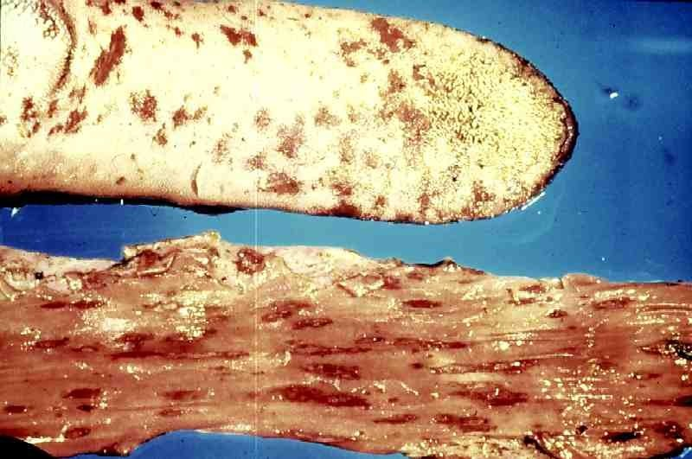
Mucosal lesions on tongue and GI tract

Slide 12
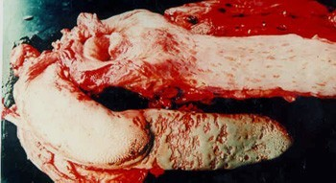

Slide 13
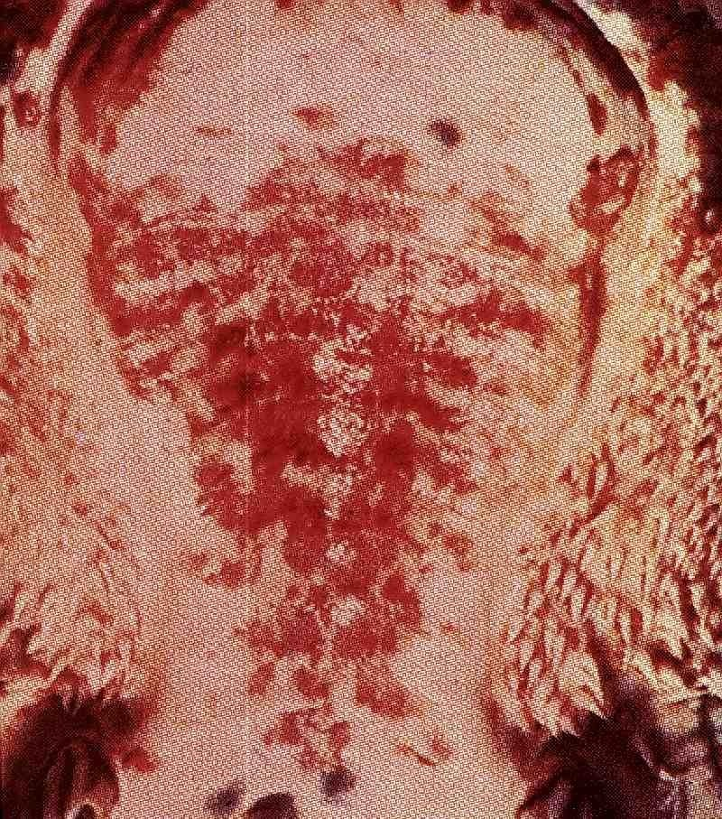
Lesion on hard palate

Slide 14
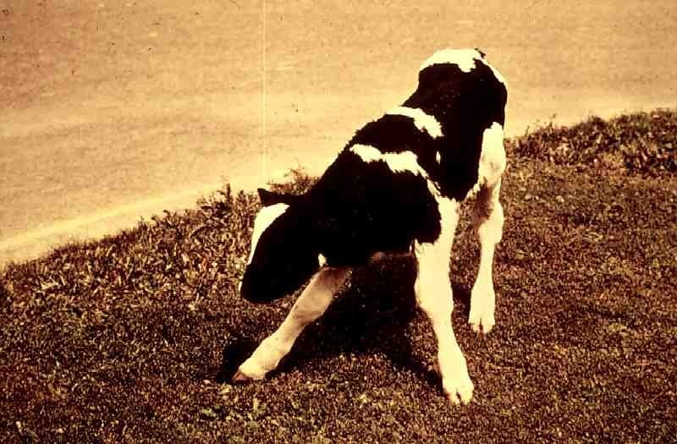
Ataxia resulting from congenital infection

Slide 15
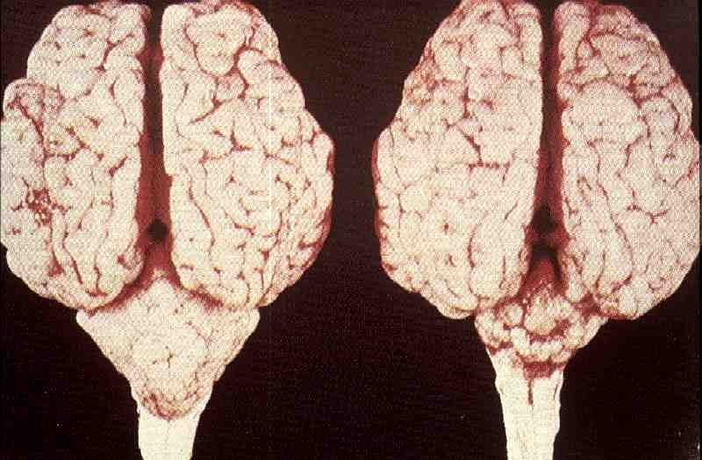
Cerebellar hypoplasia resulting from congenital infection

Slide 16
Diagnosis (1)
Virus Isolation
  Persistent Infection
    Adults — Serum
    Calves — Serum if pre colostrum or older than 4 months of age.
    Calves — Whole blood if post colostrum and less than 4 of
months age.
  Acute Infection
    Whole blood.
  Post Mortem
    Spleen, Peyer's patch, lymph nodes.
  Abortion
    Spleen, thymus.

Slide 17
Diagnosis (2)
Serology
Virus neutralization FA
Immunohistochemistry test ELISA
PCR

Slide 18

Foot and Mouth Disease (FMD)

Slide 19
Etiology
Family Picornaviridae
Genus Aphthovirus
Serotypes
  O, A, C, Asia1, SAT1, SAT2 and SAT3
  Asia1 in Asia and Middle East
  SAT1-3 in Africa
  O, A, C in European country and world wide
  Free from FMD: Scandinavia, Great Britain, North and Central America, Australia and New Zealand

Slide 20
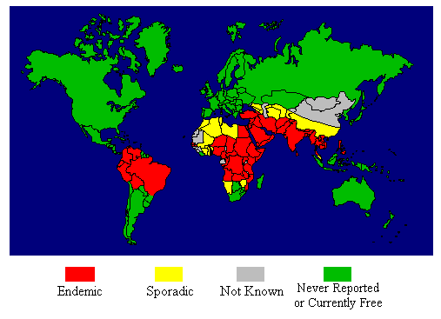

Slide 21
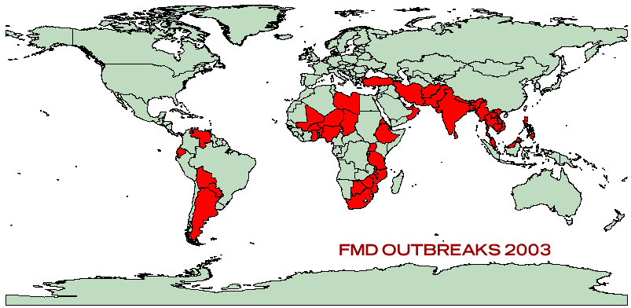

Slide 22
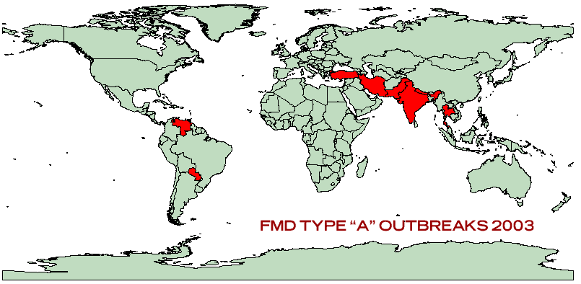

Slide 23
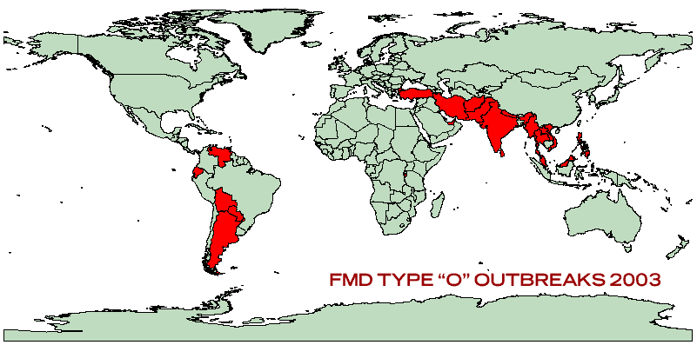

Slide 24
Resistant and Sensitivity
Sensitive
  Sunlight
  UV
  Temp >50 C
  pH changes

Slide 25

Host
All domestic and wild cloven-footed animals
Susceptibility: cattle>pig>sheep>goat
Pigs are amplifying host which can cause airborne transmission.

Slide 26
Transmission
2 main routes of infection:
  Aerosal
  Ingestion
Modes of Transmission:
  Direct contact
  Indirect contact (mechanical transfer)
    Air borne spread up to 10 kms

Slide 27
Clinical signs (1)
Incubation period 2-14 days
Fever (usually fall in about 48 hrs)
Anorexia
Depression
Drop in milk production
Development of vesicles on mouth and feet
Ruptured vesicles leading to salivation and lameness

Slide 28
Clinical signs (2)
Vesicular lesions occuring on udder and teats may become permanently infected.
Loss of condition and cessation of growth which may prolonged.
Lameness is prominent sign in pig.
Mortality is limited to young animals.
Inapparent infection: goat>sheep>pig>cattle

Slide 29
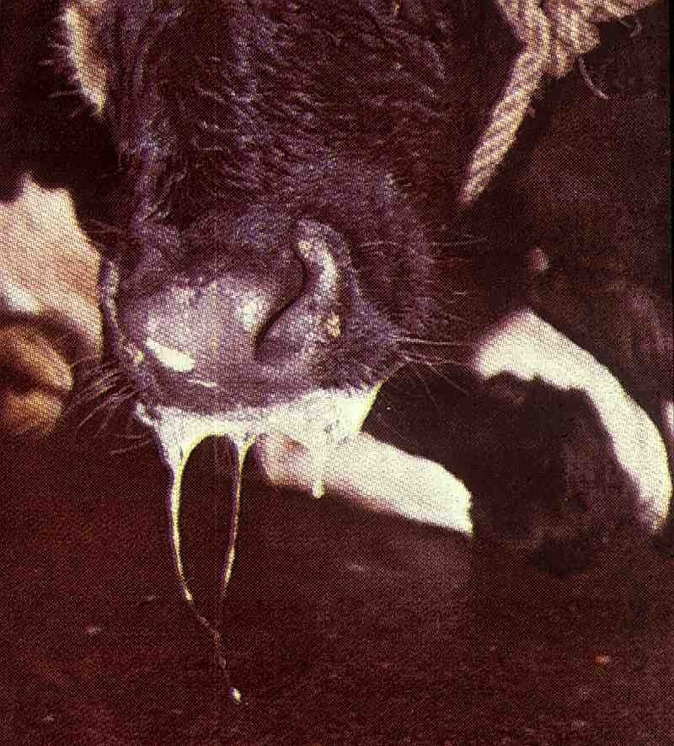

Slide 30
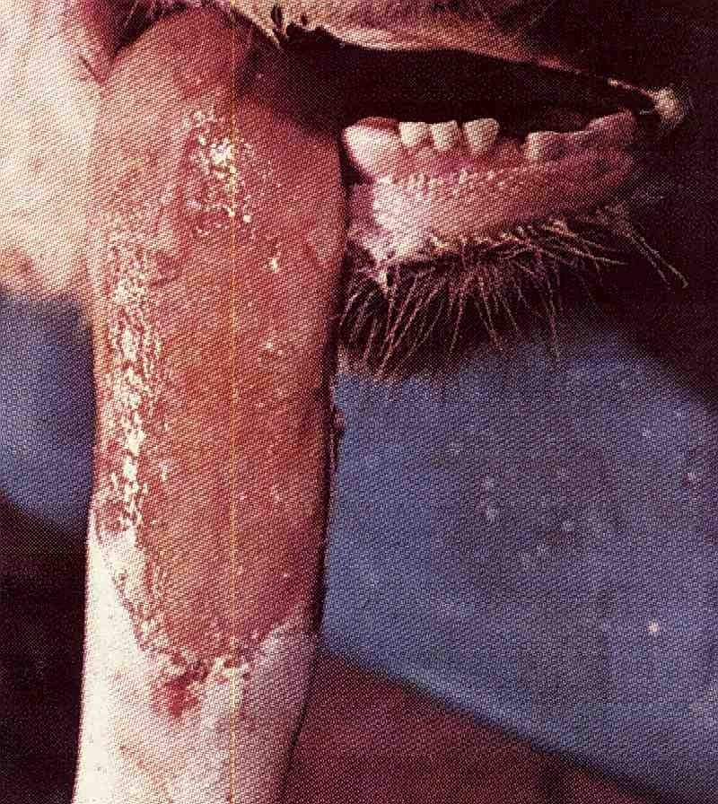

Slide 31
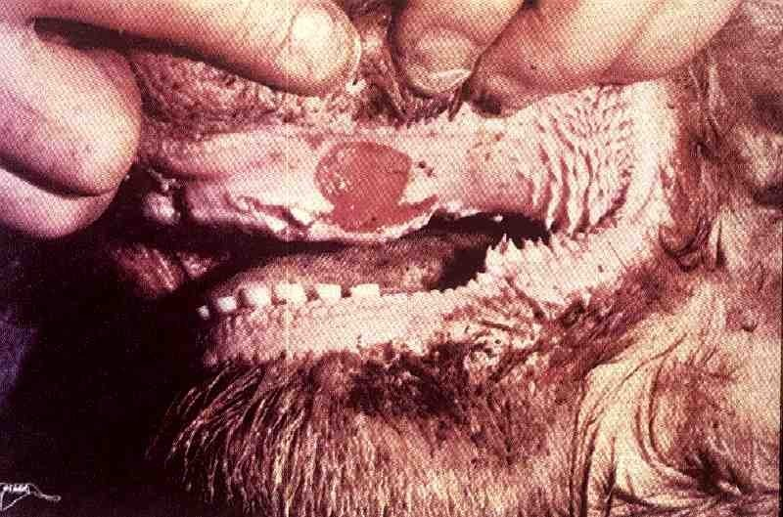

Slide 32
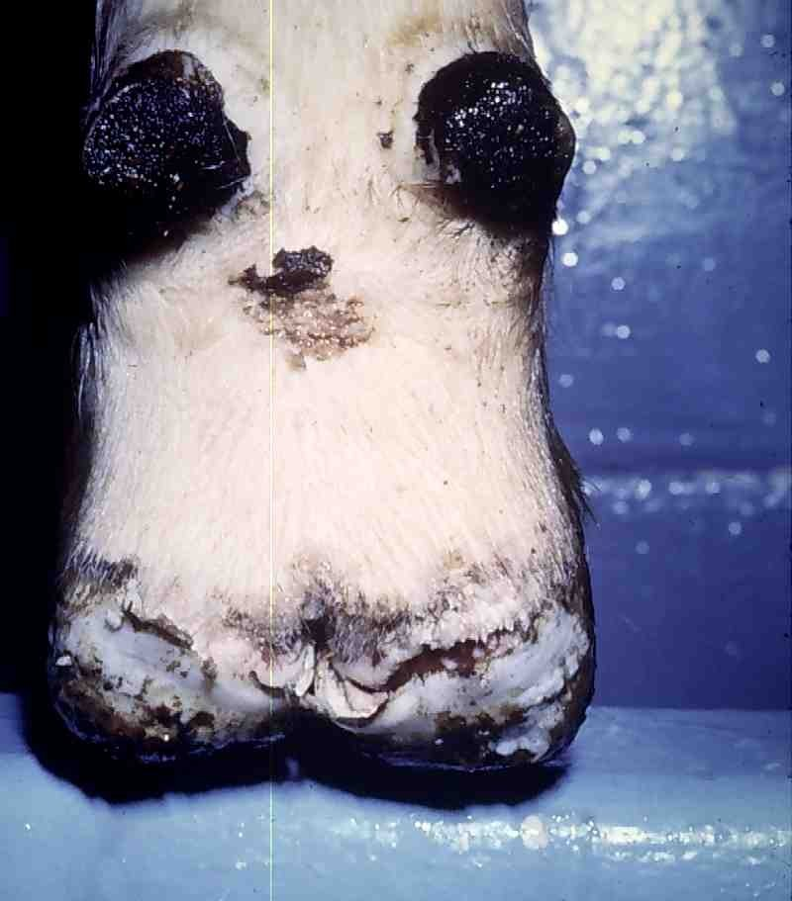

Slide 33
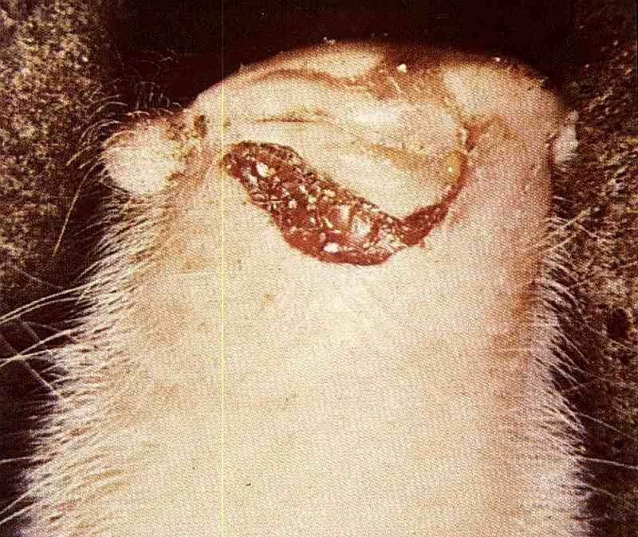

Slide 34
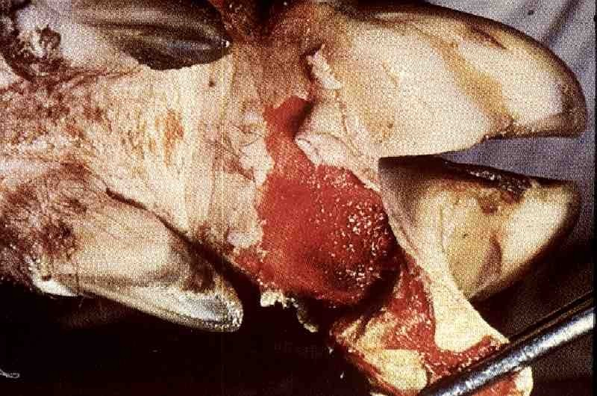

Slide 35
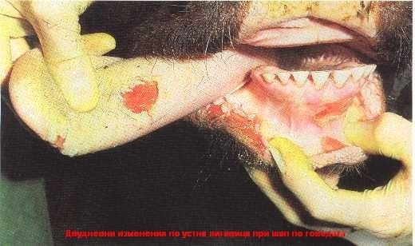

Slide 36
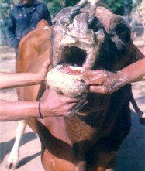

Slide 37
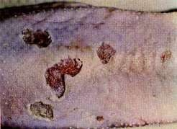

Slide 38
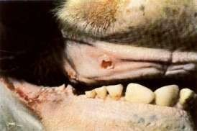

Slide 39
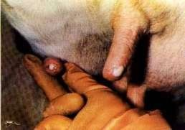

Slide 40
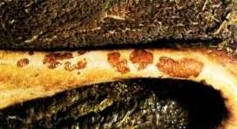
Pillars of rumens

Slide 41
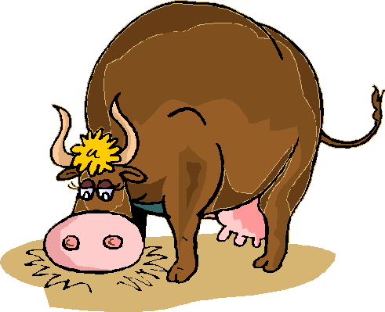
Questions?
All data is cited by
Sukolrat Boonyayatra DVM, M.S.
Clinic for Ruminant, FVM. CMU.

